Slide 1
Elasticsearch

Slide 2
Overview
Full-text search engine with clustering support
Based on Lucene library (http://lucene.apache.org/)
RESTfull interface supporting multiple languages (Java, Python, .Net, Ruby, Javascript atd.)
Use JSON as data format for document definition and commands
Created in 2010 (founder Shay ‘Kimchy’ Banon) by evolution of Compass project (ORM over Lucene), currently in version 5.6

Slide 3
Search concept – inverted index
Star Trek
ID | Token | Document
1 | star | 1,2
2 | war | 2,3
3 | world | 3
Star Wars
War of the Worlds

Slide 4
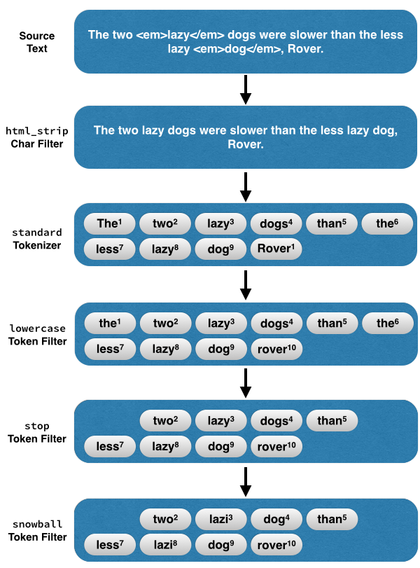
Search concept

Slide 5
Terminology comparison
RDBM
Database
Table
Row
Column
Primary/foreign key relationship
ACID by default
transactions and commiting
Groupping
Elasticsearch
Cluster
Index
Document
Field
Parent/child relationship
NOT ACID
Shard refresh and Translog flush
Aggregations

Slide 6
CRUD
GET/POST/PUT/DELETE {index}
GET/POST/PUT/DELETE {index}/{type}/{id}
POST {index}/{type}/{id}/_update { “doc” : {….} }

Slide 7
Exercise #1
Practice index CRUD operation
Practice document CRUD operation
Practice partial updating
Practice version locking

Slide 8
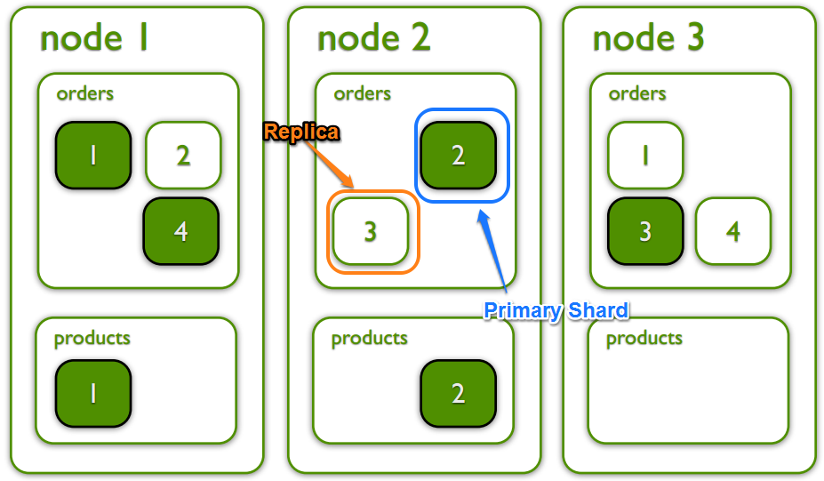
Clustering

Slide 9
Clustering – shards & routing
Replicas can be added/removed anytime
By default cluster balances shards over all nodes
Single node can’t own two shards with same data
Documents are routed to shard with formula:
shard = hash(routing) % number_of_primary_shards
Number of primary shards can’t be changed

Slide 10
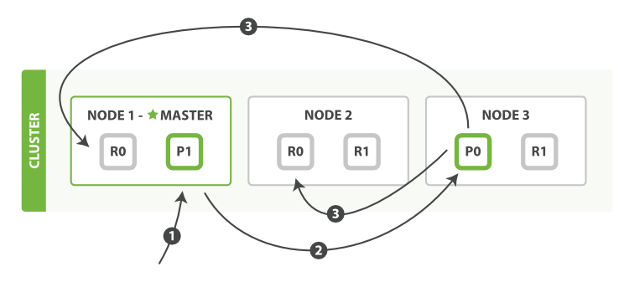
Clustering and shards
https://www.elastic.co/blog/every-shard-deserves-a-home
1. Index request to Node 1
2. Request routed to corresponding primary shard (P0)
3. Request send to replicas once primary is indexed
4. Returning success to Node 1

Slide 11
Cluster health status
Health is determined by the “worst” shard status
Red – at least one index is not complete(shards missing)
Yellow – all primary shards allocated some replicas are not
Green – all shards are allocated
GET /_cluster/health?wait_for_status=yellow

Slide 12
Exercise #2
Run another elastic in your machine
Watch shard distribution when 3rd node appears
Shutdown 2nd and 3rd node
Increase # of replicas
Shutdown 2nd and 3rd node

Slide 13
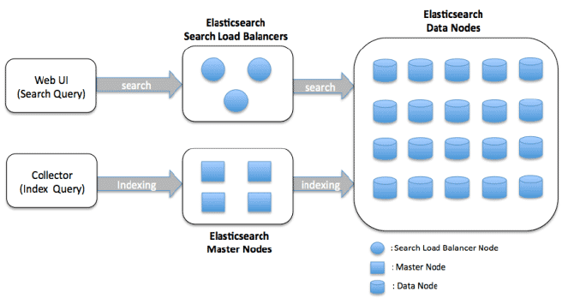
Node types
Data node – storage for Lucene documents.
Search/coordinating node – do not store any data, takes care of requesting other nodes and aggregation of search results
Ingest node – provides pre-processing pipeline for documents
Master node – routes documents for indexing, rebalancing index, handles recovery
Tribe/Cross cluster – “clustered clusters”. Client with ability of searching amongs multiple clusters

Slide 14
Node type configuration
Configuration in elasticsearch.yml
node.master: false
node.data: true
node.ingest: false
search.remote.connect: false

Slide 15
Mapping
Every index has mapping (similar to DB schema)
By default index has dynamic mapping
new fields can be added on the fly
limiting is possible (max fields, depth etc)
explicit mapping is also possible
Mappings can be changed during time (only add/remove)
Fields are shared across multiple index types!!
Types will be deprecated (6.0.0+) and deleted in the future (7.0.0+)

Slide 16
Default fields (meta-fields)
_index- virtual field containing name of index
_type – index type, used in searching by type
_id unique identification in index (_uid compose type and id)
_source – original JSON representing document
_size – size of _source in bytes
_all – “catch all” field that indexes all values from all fields
_field_names – all document fields that does have non-null value
_parent – creates parent-child relationship between two types
_routing – custom routing value which directs document to shard
_meta – application specific field (

Slide 17
Core datatypes
String
text and keyword
Numeric datatypes
long, integer, short, byte, double, float, half_float, scaled_float
Date datatype
date
Boolean datatype
boolean
Binary datatype
binary
Range datatypes
integer_range, float_range, long_range, double_range, date_range

Slide 18
Datatypes settings
coerce – true (default)/false benevolent to different types
boost – float type (1.0) for increase importance in searching
include_in_all – true (default)/false – presence in _all field
Index – true (default)/false – should this field be searched
store – true/false (default)

Slide 19
Datatypes settings
coerce – true (default)/false benevolent to different types
boost – float type (1.0) for increase importance in searching
include_in_all – true (default)/false – presence in _all field
Index – true (default)/false – should this field be searched
store – true/false (default)

Slide 20
Exercise #3
A) Create index author with two types “book” and “author”
B) For “author” create text field “name”
C) For “book” create text field “name” and int field “year”

Slide 21
Bulk API
Ability to index multiple documents per single request
Uses new line JSON (NDJSON)
Format:
action_and_meta_data\n
optional_source\n
action_and_meta_data\n
optional_source\n
Actions
create – create a document only if it does not already exist
Index – create or replace existing document
update – do a partial update of existing document
delete – remove existing document

Slide 22
Exercise #4
1) Insert 2 authors to /author/author and 1 book via bulk API
2) Verify that book and authors exists
3) Delete through bulk API book

Slide 23
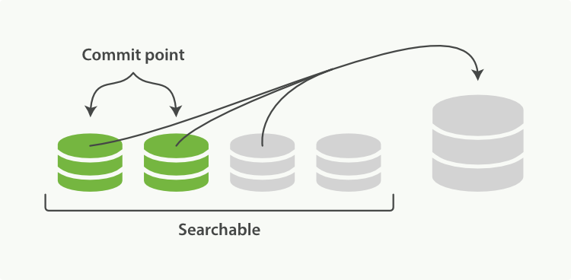
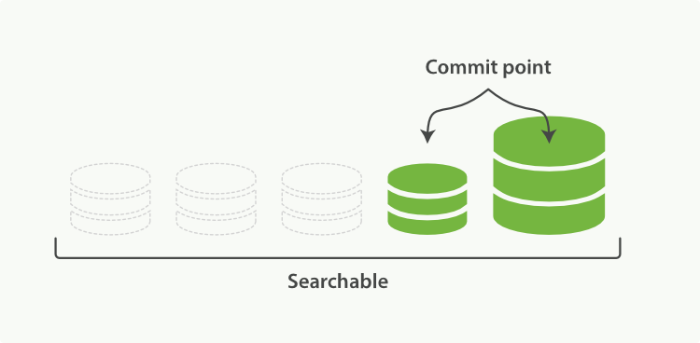
Merging

